Slide 2
Innovation in
Distance Education
and e-Learning
Joao Mattar
June 24, 2015

Slide 3
Innovations
Adaptive Learning
Games & Gamification
Social Networks
Mobile Learning
MOOCs

Slide 4
1. Adaptive Learning

Slide 5
Digital Natives

Slide 6
Digital Immigrants

Slide 7
Homo Zappiens

Slide 8
2. Games

Slide 9
Gamification
Notes:
Gamification is a newer term

Slide 10
Definition
“Gamification is the use of game design elements in non-game contexts.”
(Deterding et al, 2011)
Game design elements: interaction, collaboration, cooperation, challenges, competition, awards etc.

Slide 12
Universidade do Futebol

Slide 13
Universidade do Futebol

Slide 14
Universidade do Futebol

Slide 15
Universidade do Futebol

Slide 16
3. Social Networks

Slide 17
Social Networks

Slide 18
LMS x Social Networks
400% more posts by Chemistry students on a Facebook group than on WebCT (Schroeder and Greenbowe, 2009).
39% of Pharmacy students reported never looking at the Blackboard discussion board for the course, whereas almost all students followed the Facebook page (DiVall and Kirwin, 2012).
Most IT students prefer WhatsApp compared to Blackboard (Bere, 2012).

Slide 19
4. Mobile Learning

Slide 20
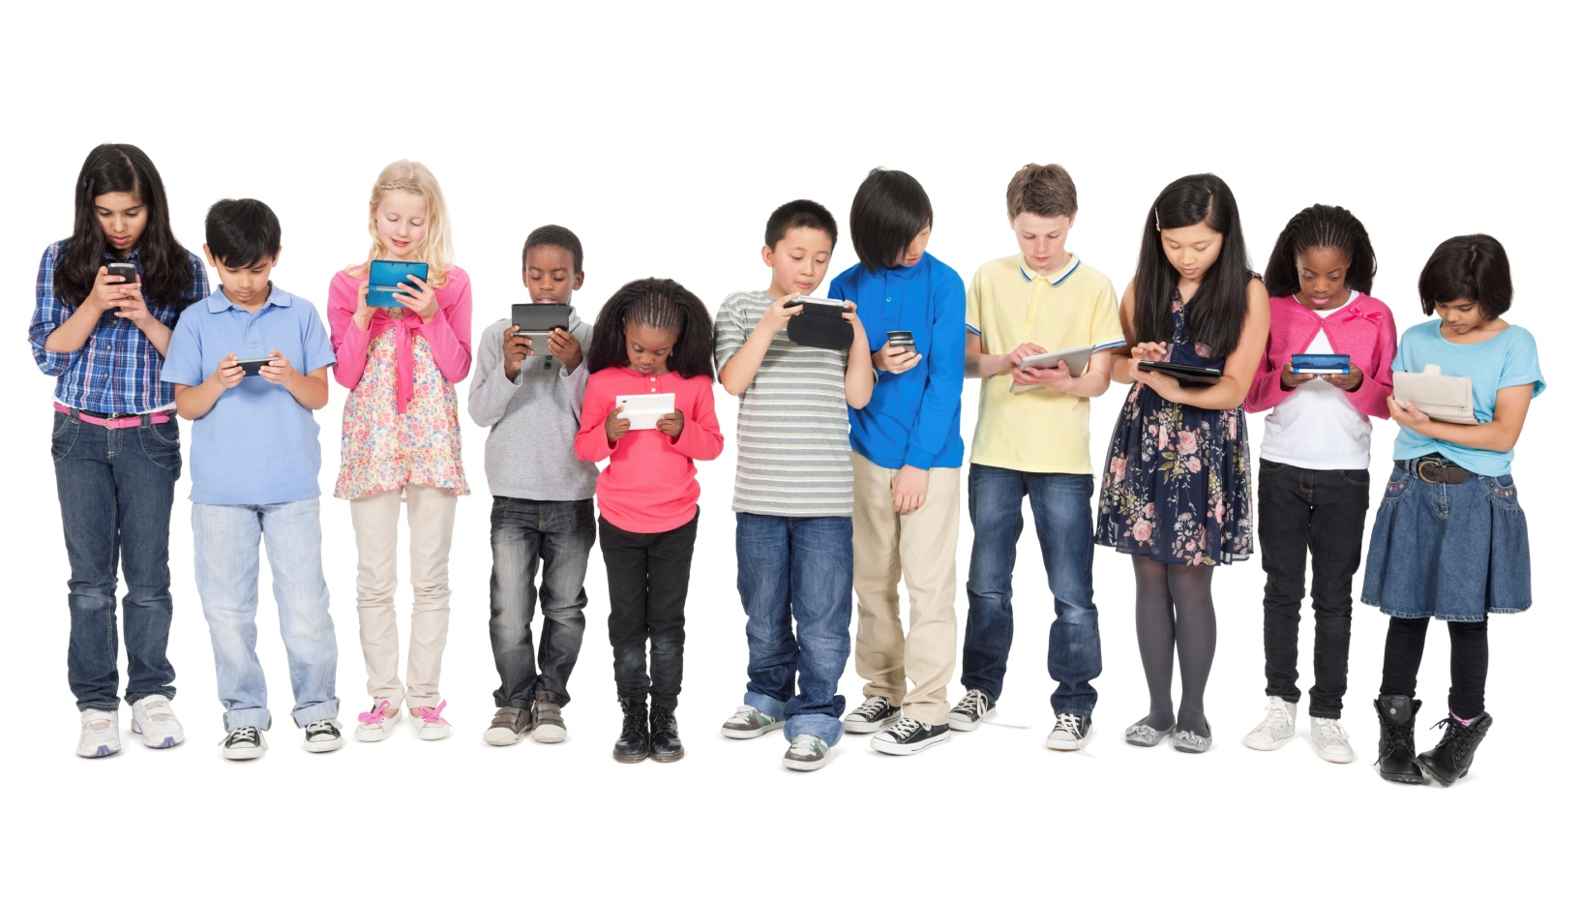
BYOD

Slide 21
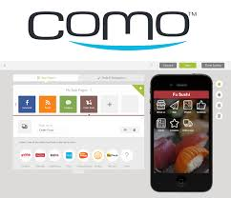
Build your App

Slide 22
Learn Guitar

Slide 23
5. MOOCs

Slide 24
Selection
Public Policy Challenges of the 21st Century
Comprendre l’exercice de la Justice: panorama des institutions juridictionnelles
Derecho civil foral valenciano
Введение в российское налоговое право
国际刑法学

Slide 25
Best Practices

Slide 26
Content Production

Slide 27
Collaboration

Slide 28
Tools

Slide 29
Tutoring

Slide 30
e-Portfolios

Slide 31
Learning Analytics

Slide 32
Hybrid Learning

Slide 33
Blended Learning

Slide 34
Educational Technology

Slide 35
Tips

Slide 36
Research Agenda

Slide 37
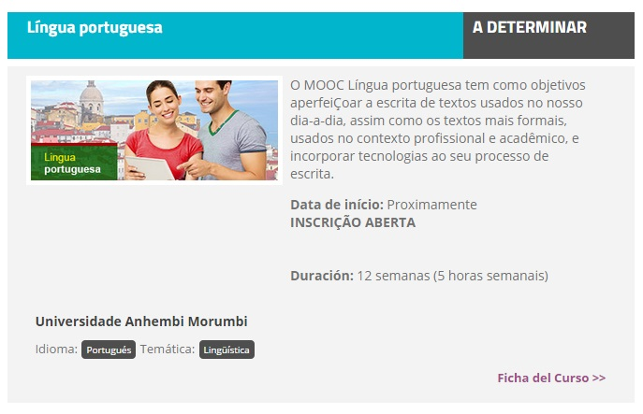
Portuguese MOOC

Slide 38
International Congress

Slide 39
References
BERE, A. (2012). A comparative study of student experiences of ubiquitous learning via mobile devices and learner management systems at a South African university. In ANNUAL CONFERENCE ON WORLD WIDE WEB APPLICATIONS, 14., 2012, Durban. Proceedings... Durban, 7-9 nov. 2012.
DETERDING, S. et al. From game design elements to gamefulness: defining “gamification”. In: 15th International Academic Min dTrek Conference: Envisioning Future Media Environments, MindTrek 2011, Tampere, 2011. p. 9 - 15.
DIVALL, M., & KIRWIN, Jennifer L. (2012). Using Facebook to facilitate course-related discussion between students and faculty members. American Journal of Pharmaceutical Education, 76(2), 32 . Please verify that article is only one page.
32 is the number of the article. There are no number of pages on this Journal.
SCHROEDER, J., & GREENBOWE, T. J. (2009). The chemistry of Facebook: Using social networking to create an online community for the organic chemistry laboratory. Innovate: Journal of Online Education, 5(4).
VEEN, W.; VRAKKING, B. Homo Zappiens: growing up in a digital age. London: Network Continuum Education, 2007.
ZAWACKI-RICHTER, Olaf; ANDERSON, Terry (Ed.). (2014). Online Distance Education: Towards a research agenda. Athabasca University Press.
Images: istockphoto.com

Slide 40
João Mattar
joaomattar@gmail.com
joaomattar.com/blog
facebook.com/joaomattar
slideshare.net/joaomattar
Notes:
Thank you very much

